Slide 1

save and restore

Slide 2
Reference
Chapter 13 (O'Reilly) of Hands-On ML
Hvass Lab’s GitHub and Youtube
Youtube on Transfer Learning using Inception Version 3 2015
Youtube
Code

Slide 3
Download flower

Slide 4
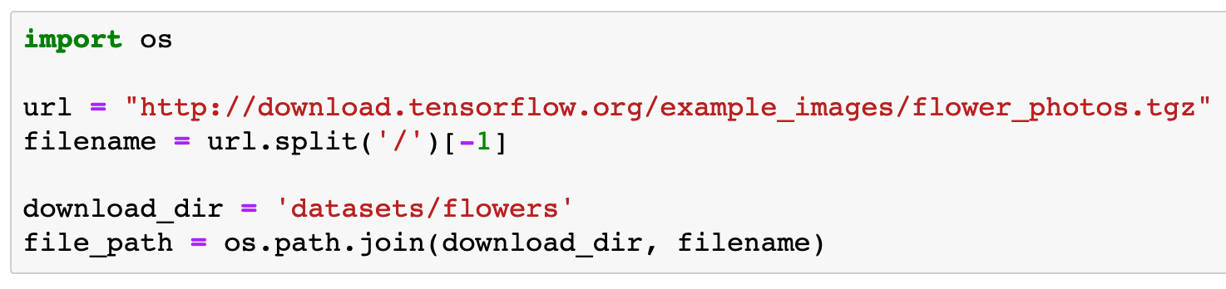

Slide 5
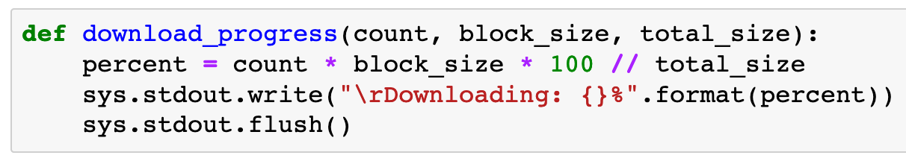

Slide 6
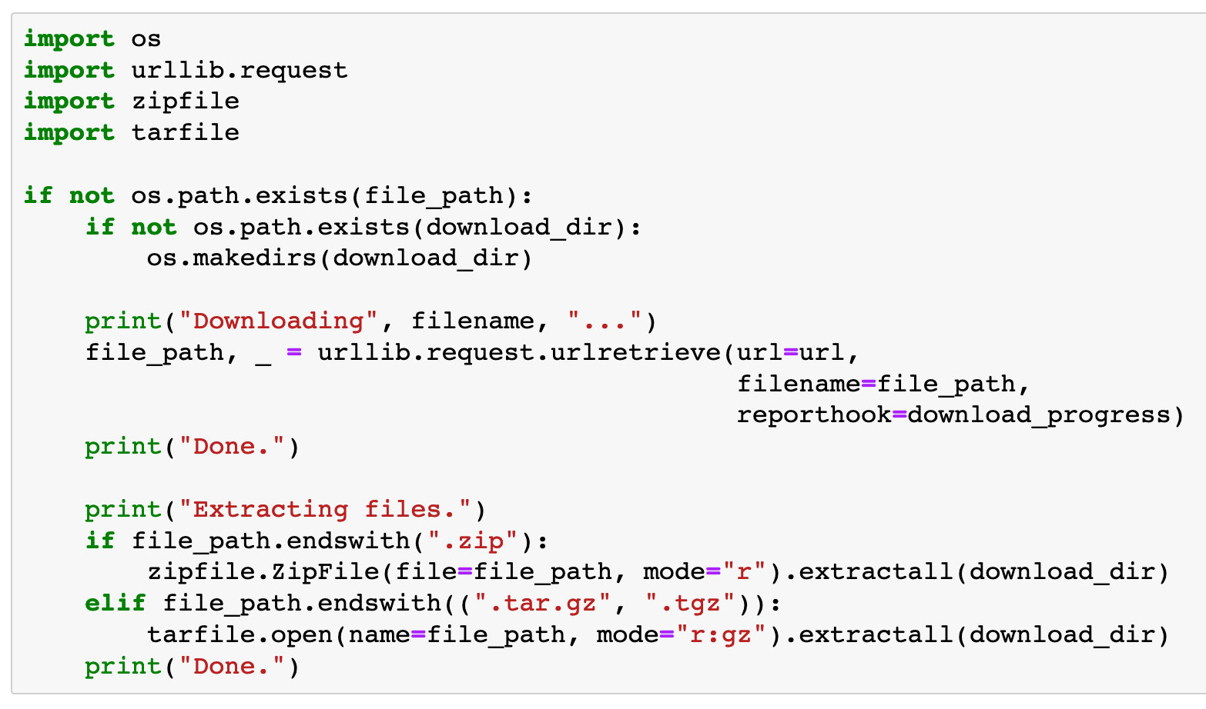

Slide 7
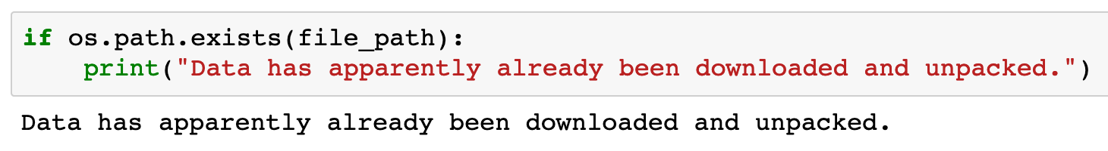

Slide 8
Create flower_classes list

Slide 9
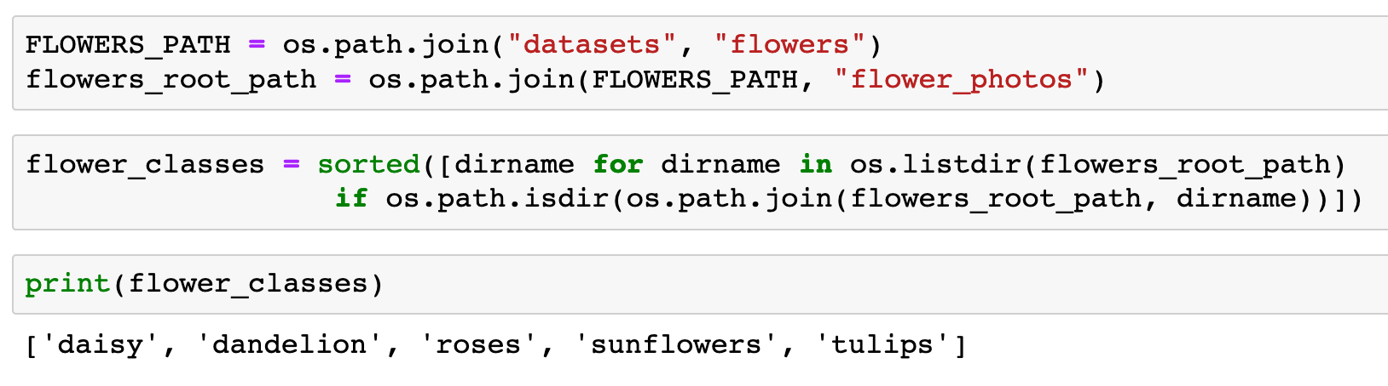


Slide 12
Create image_paths dict

Slide 13
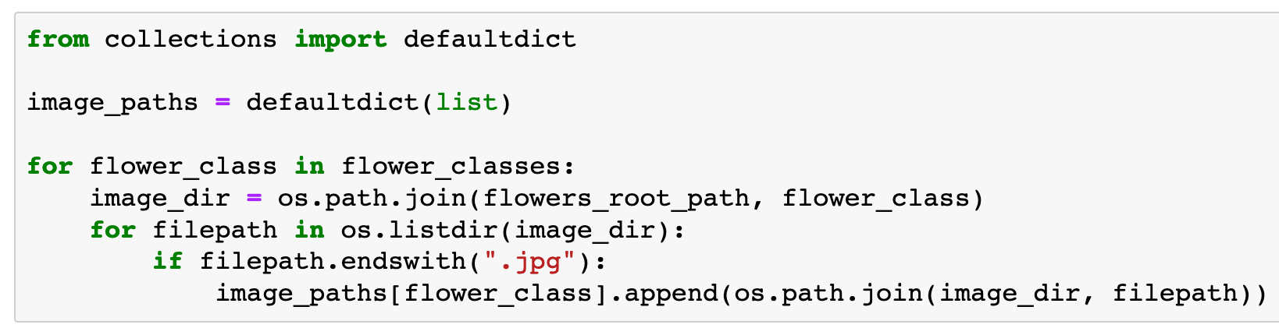

Slide 14
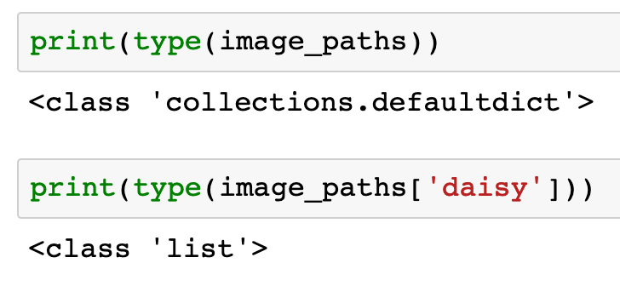

Slide 16
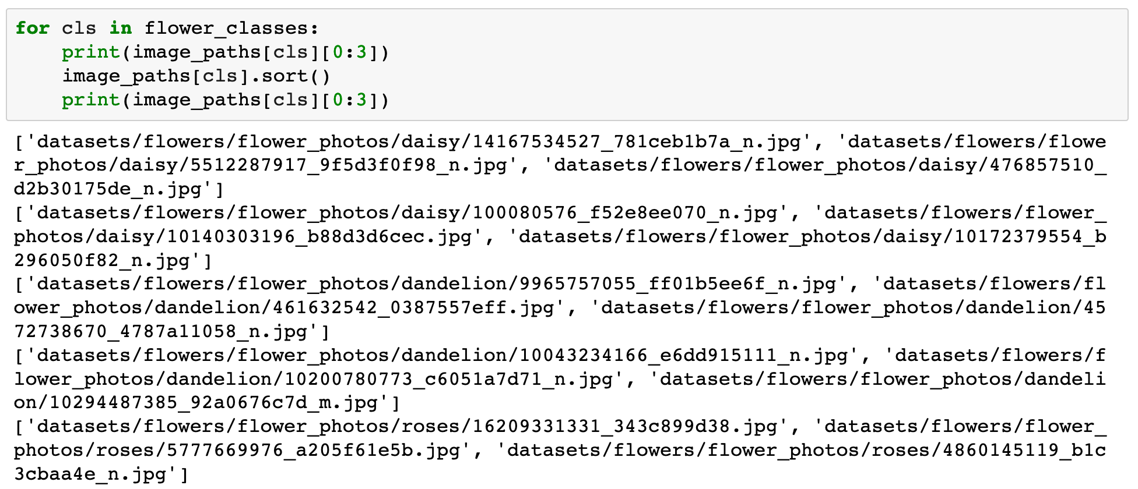

Slide 17
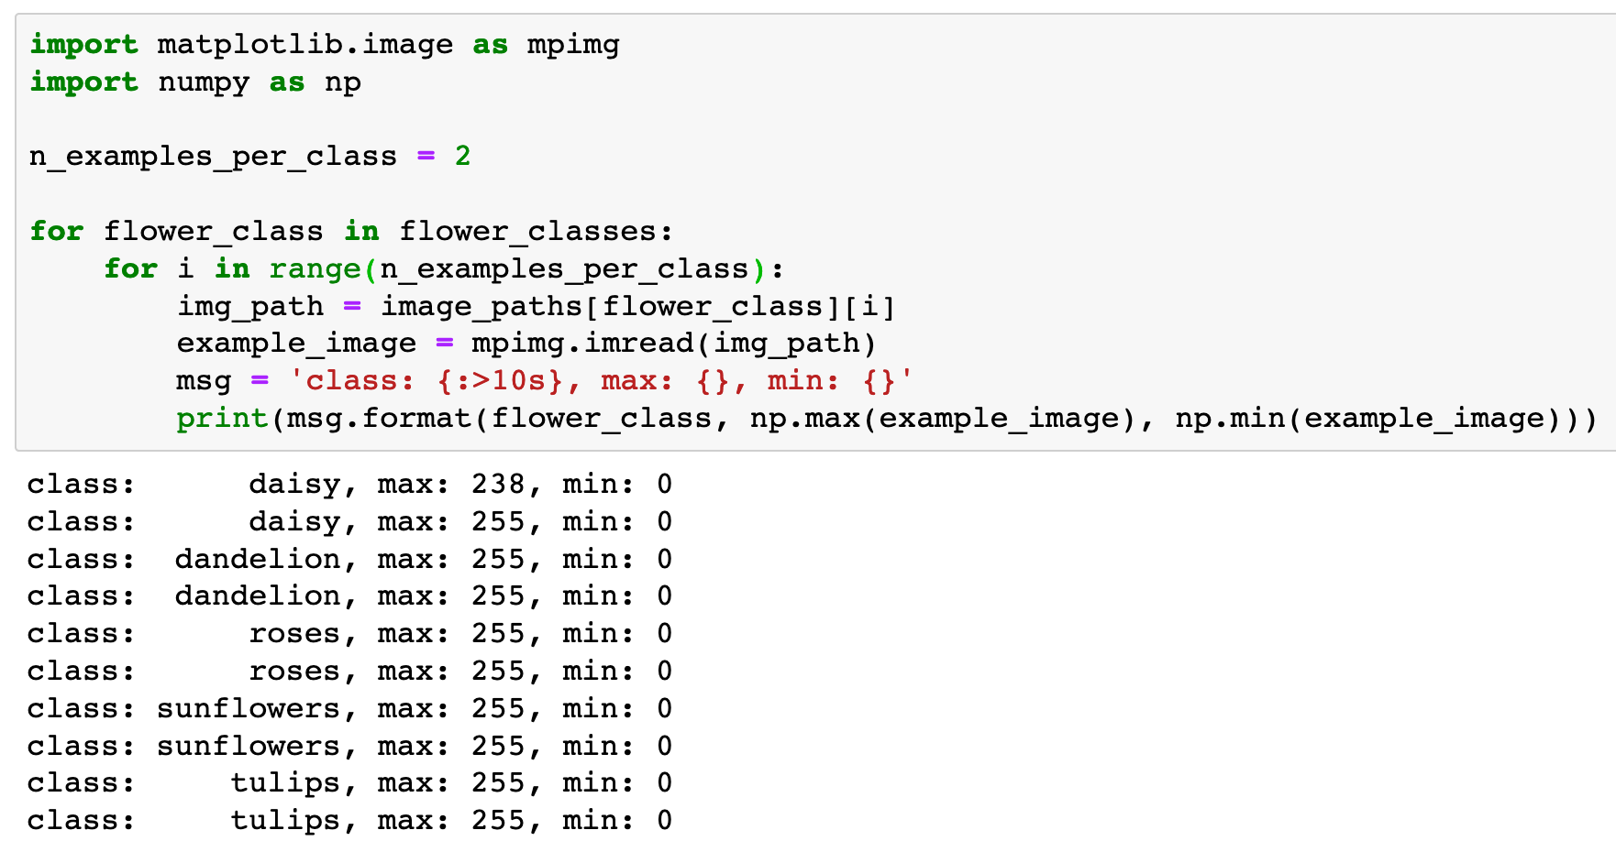

Slide 18
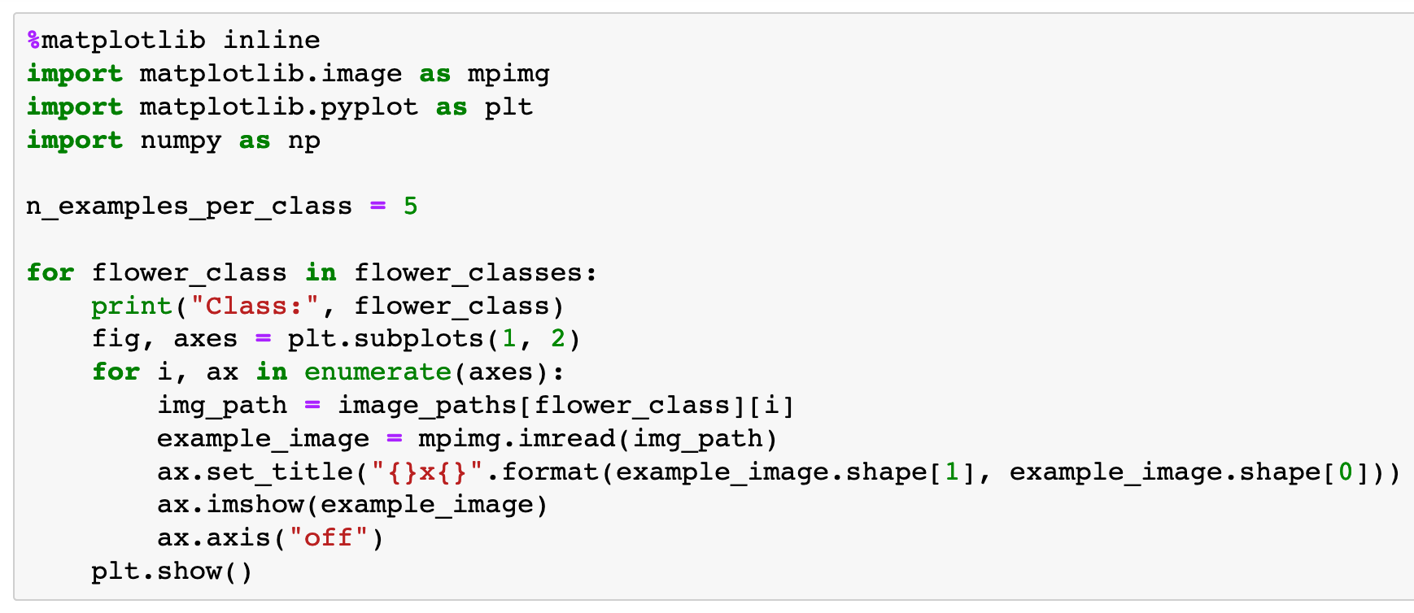

Slide 19
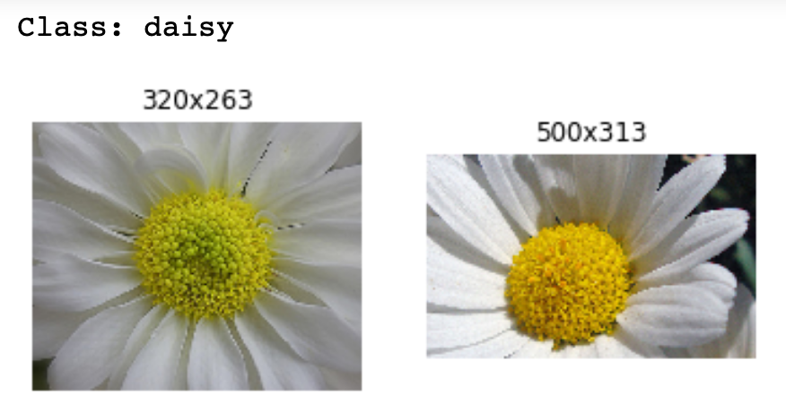

Slide 20
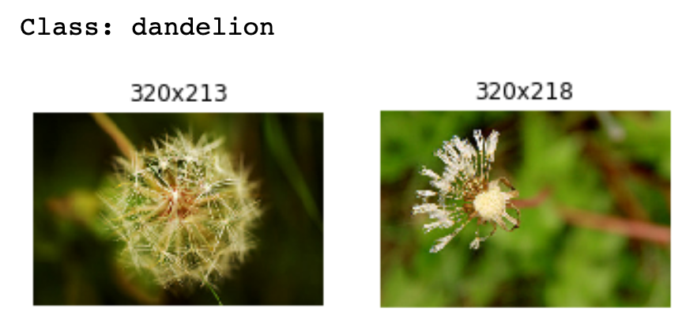

Slide 21
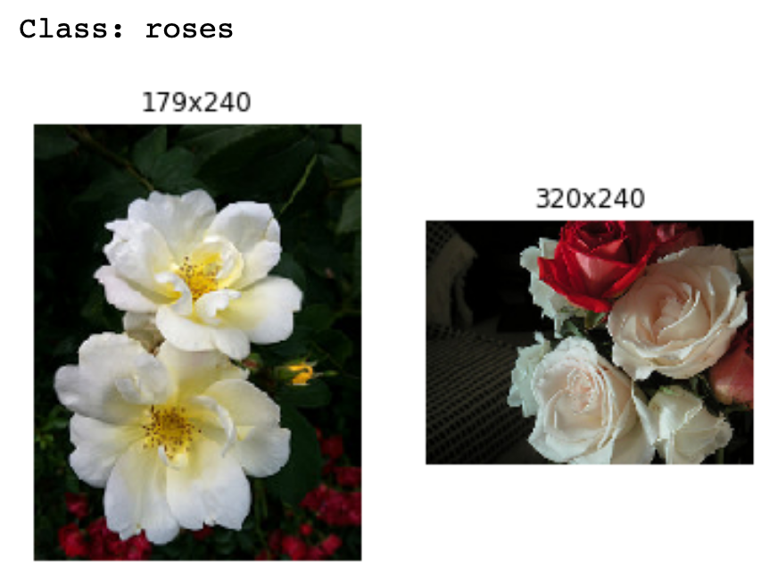

Slide 22
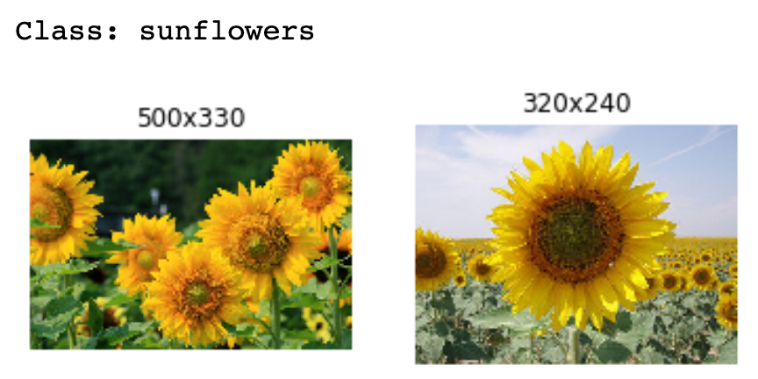

Slide 23
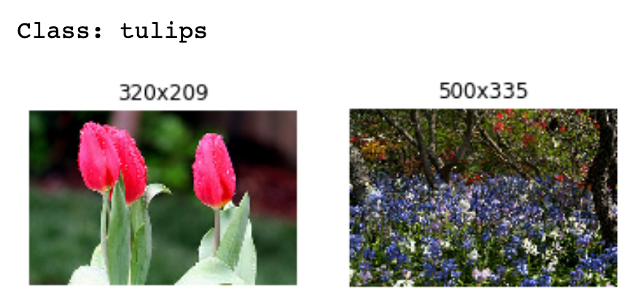

Slide 24
Random Cropping

Slide 25
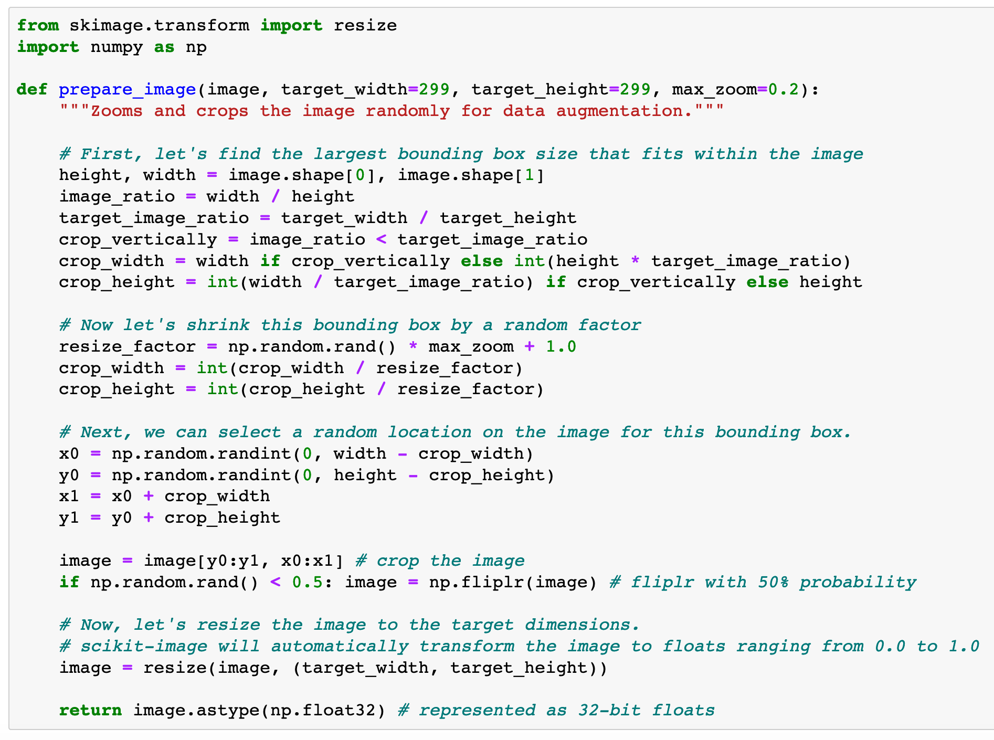

Slide 26
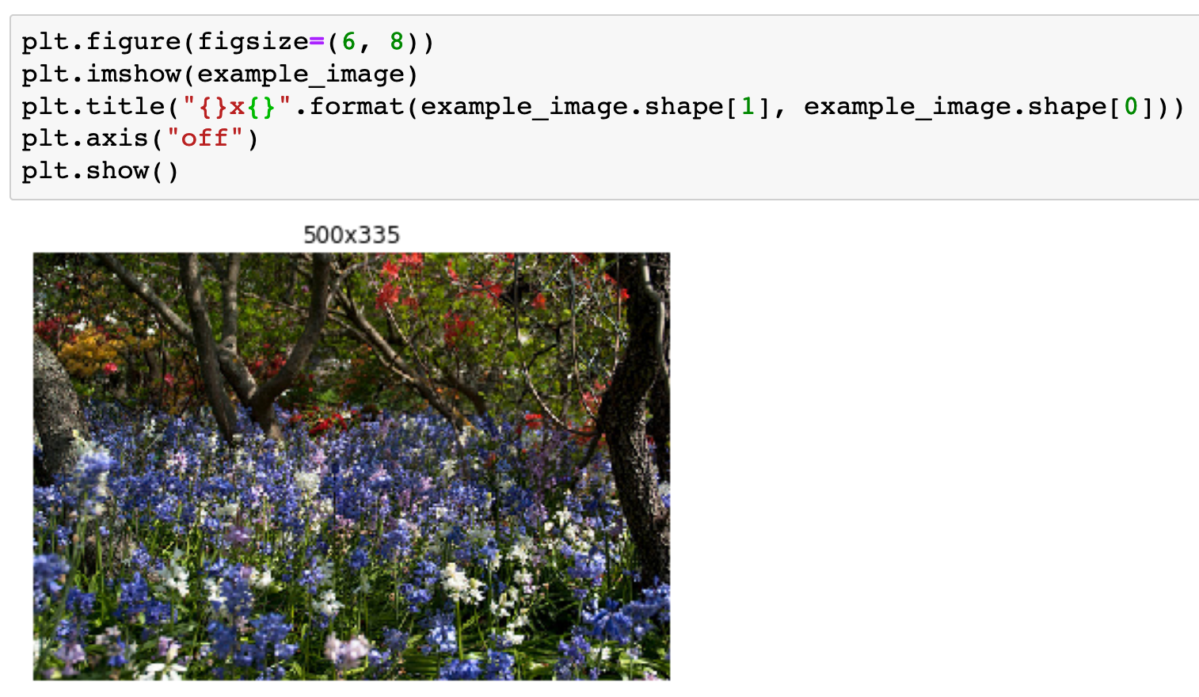

Slide 27
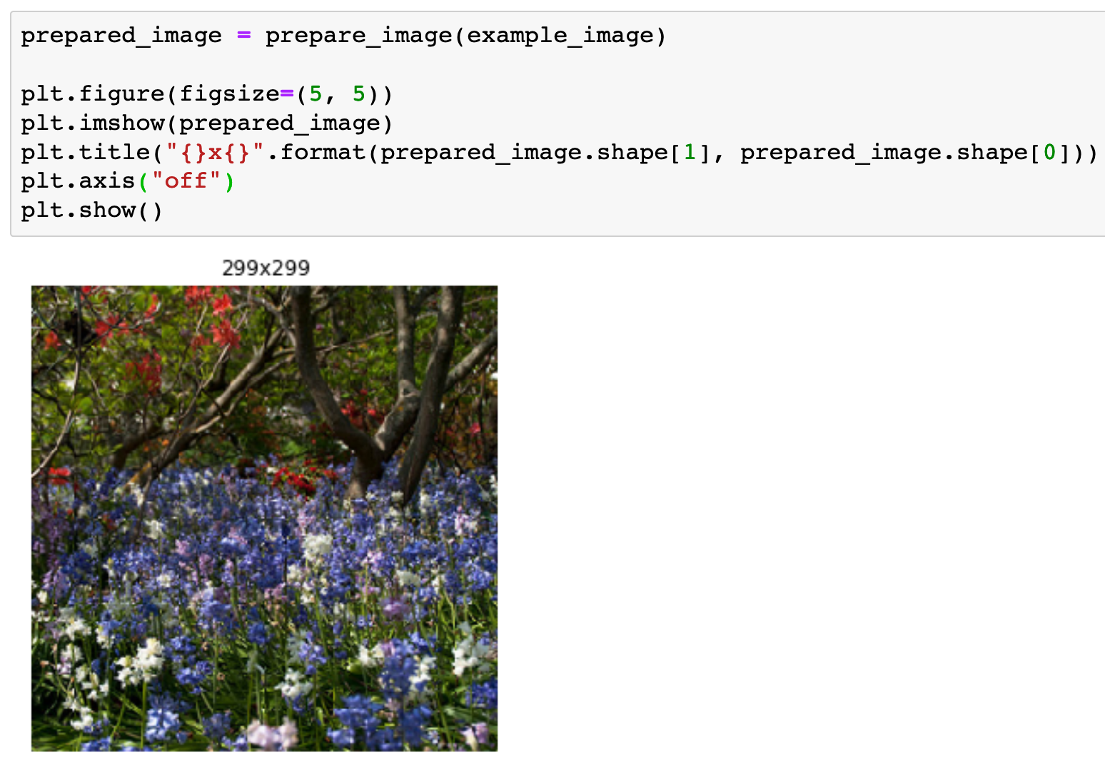

Slide 28
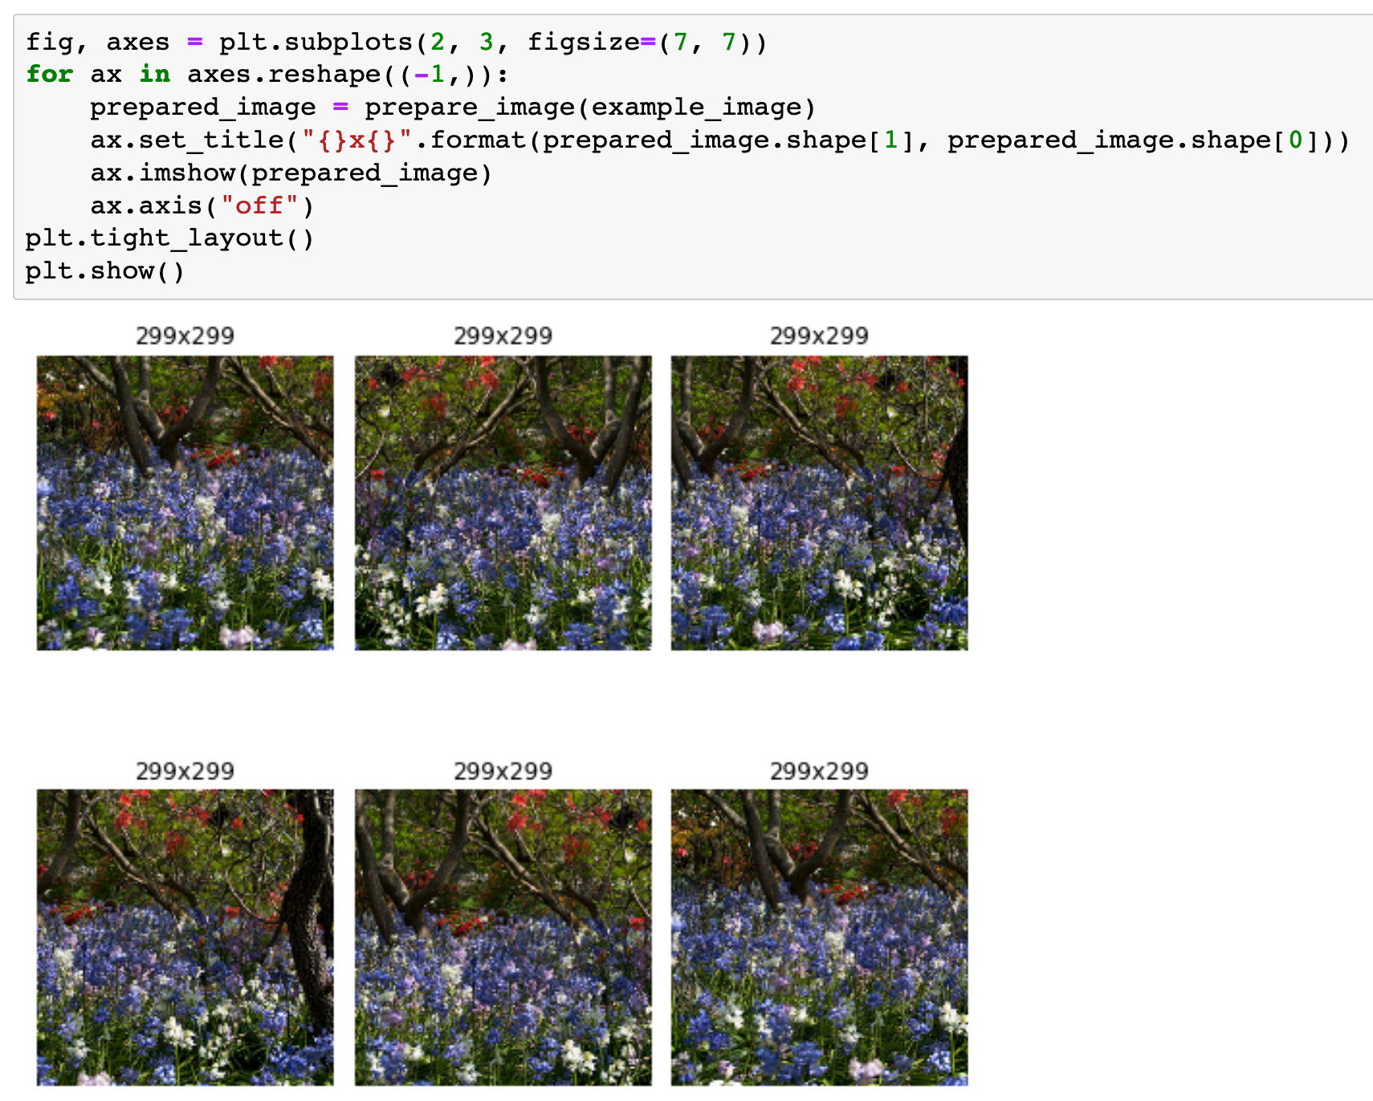

Slide 29
Random Cropping with TensorFlow

Slide 30
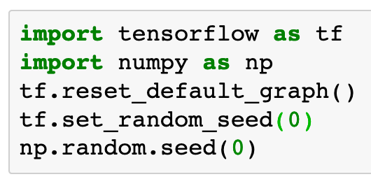

Slide 31
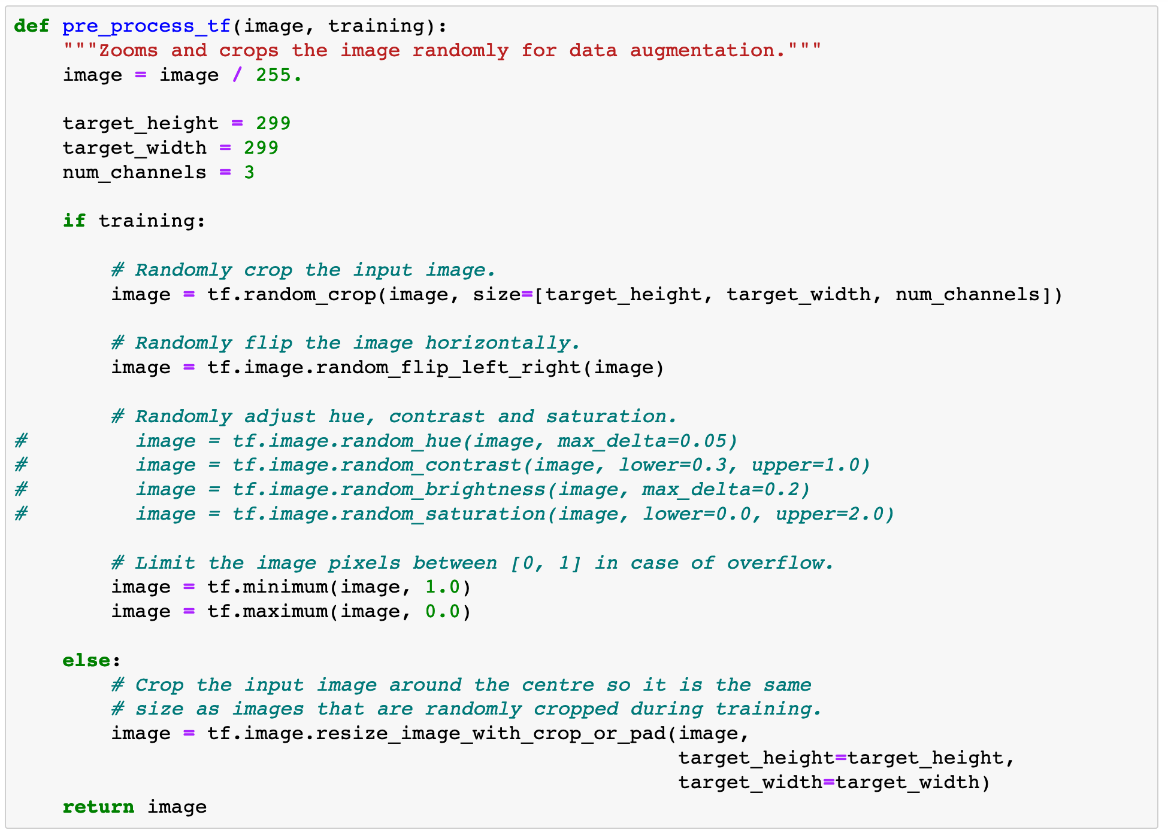

Slide 32
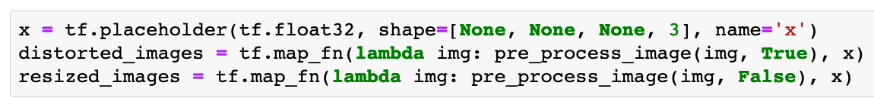

Slide 33
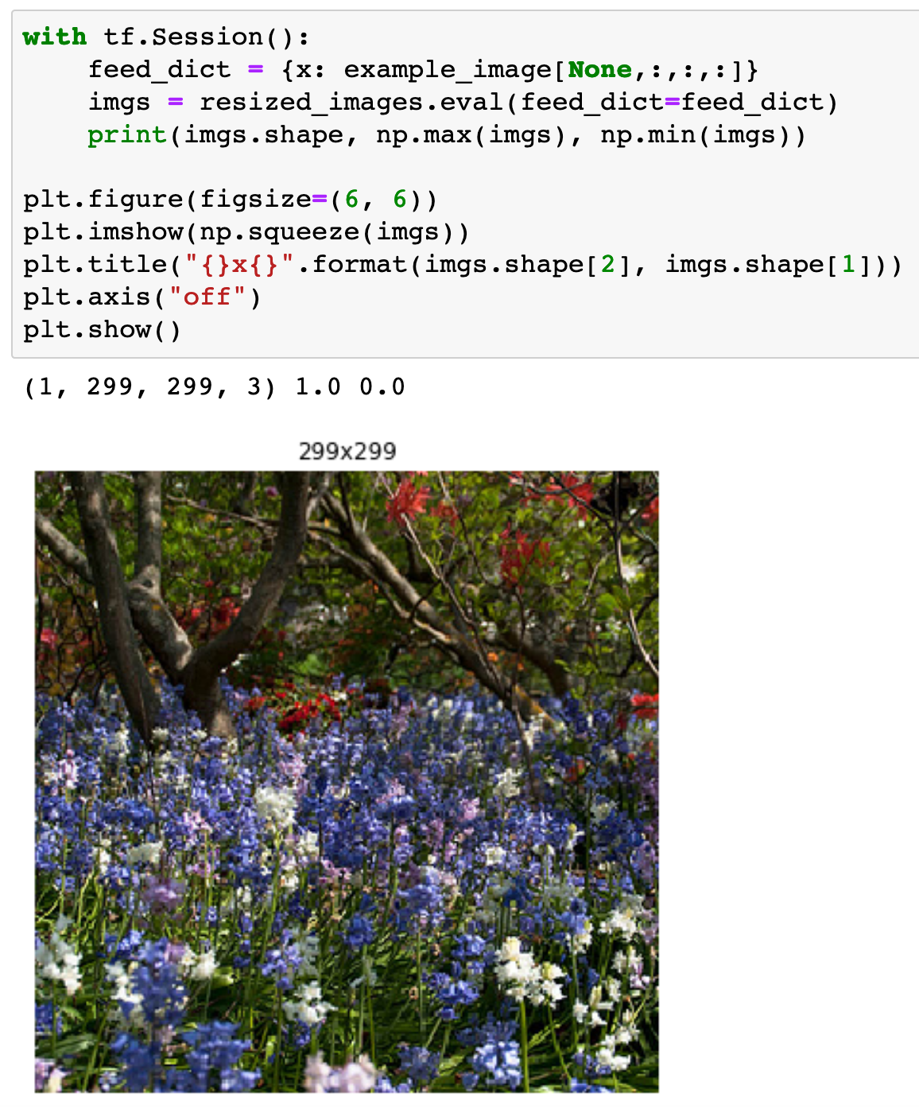

Slide 34
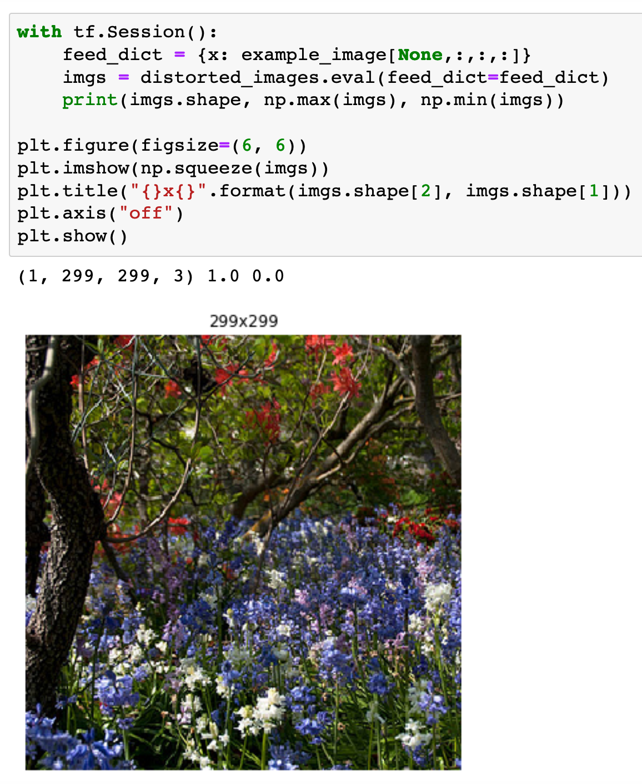

Slide 35
Inception v3 2016 Download

Slide 36
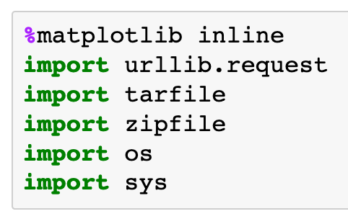

Slide 38
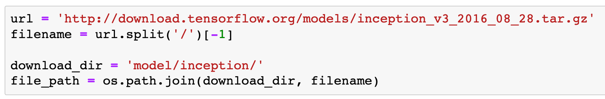

Slide 39
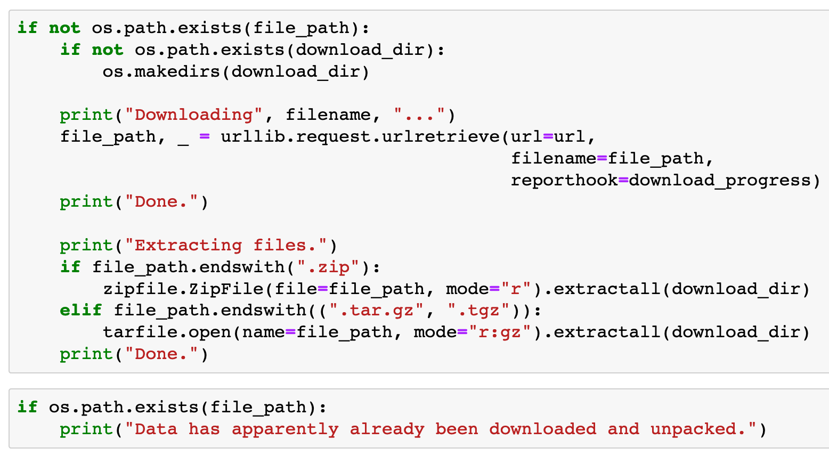

Slide 40
Restore Graph

Slide 41
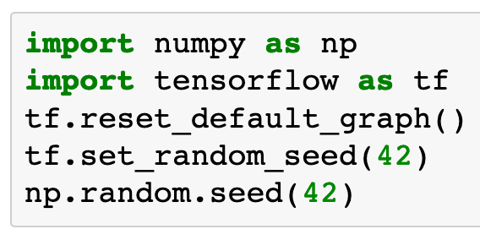

Slide 42
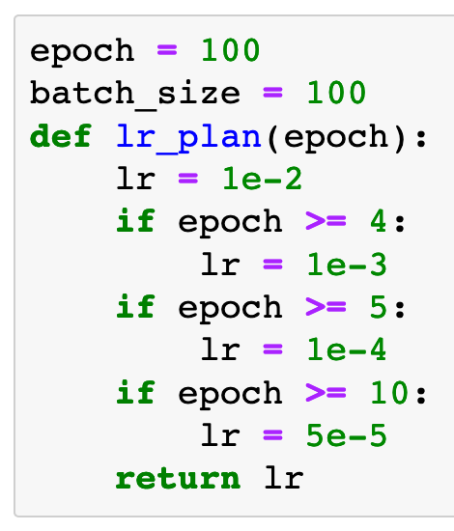


Slide 44
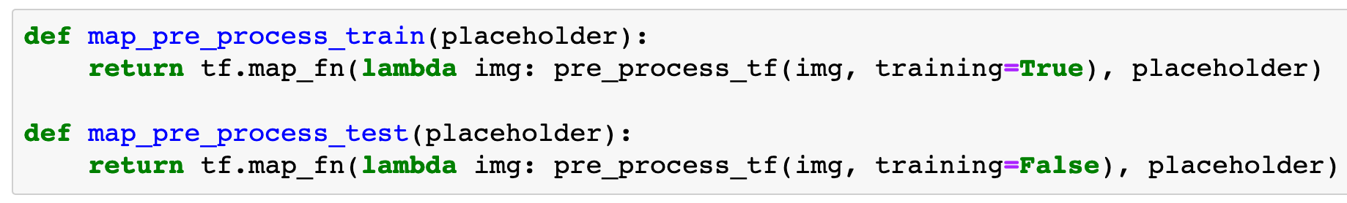

Slide 45
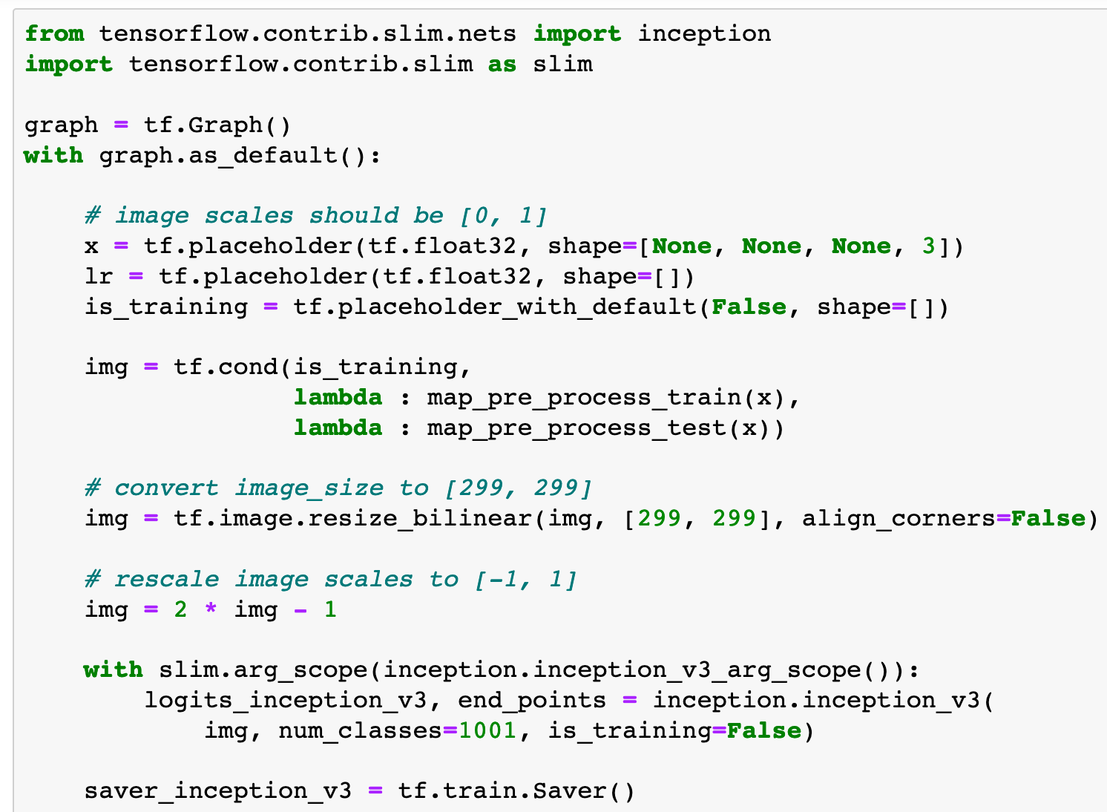

Slide 46
These should be
callable

Slide 47
should be here

Slide 48
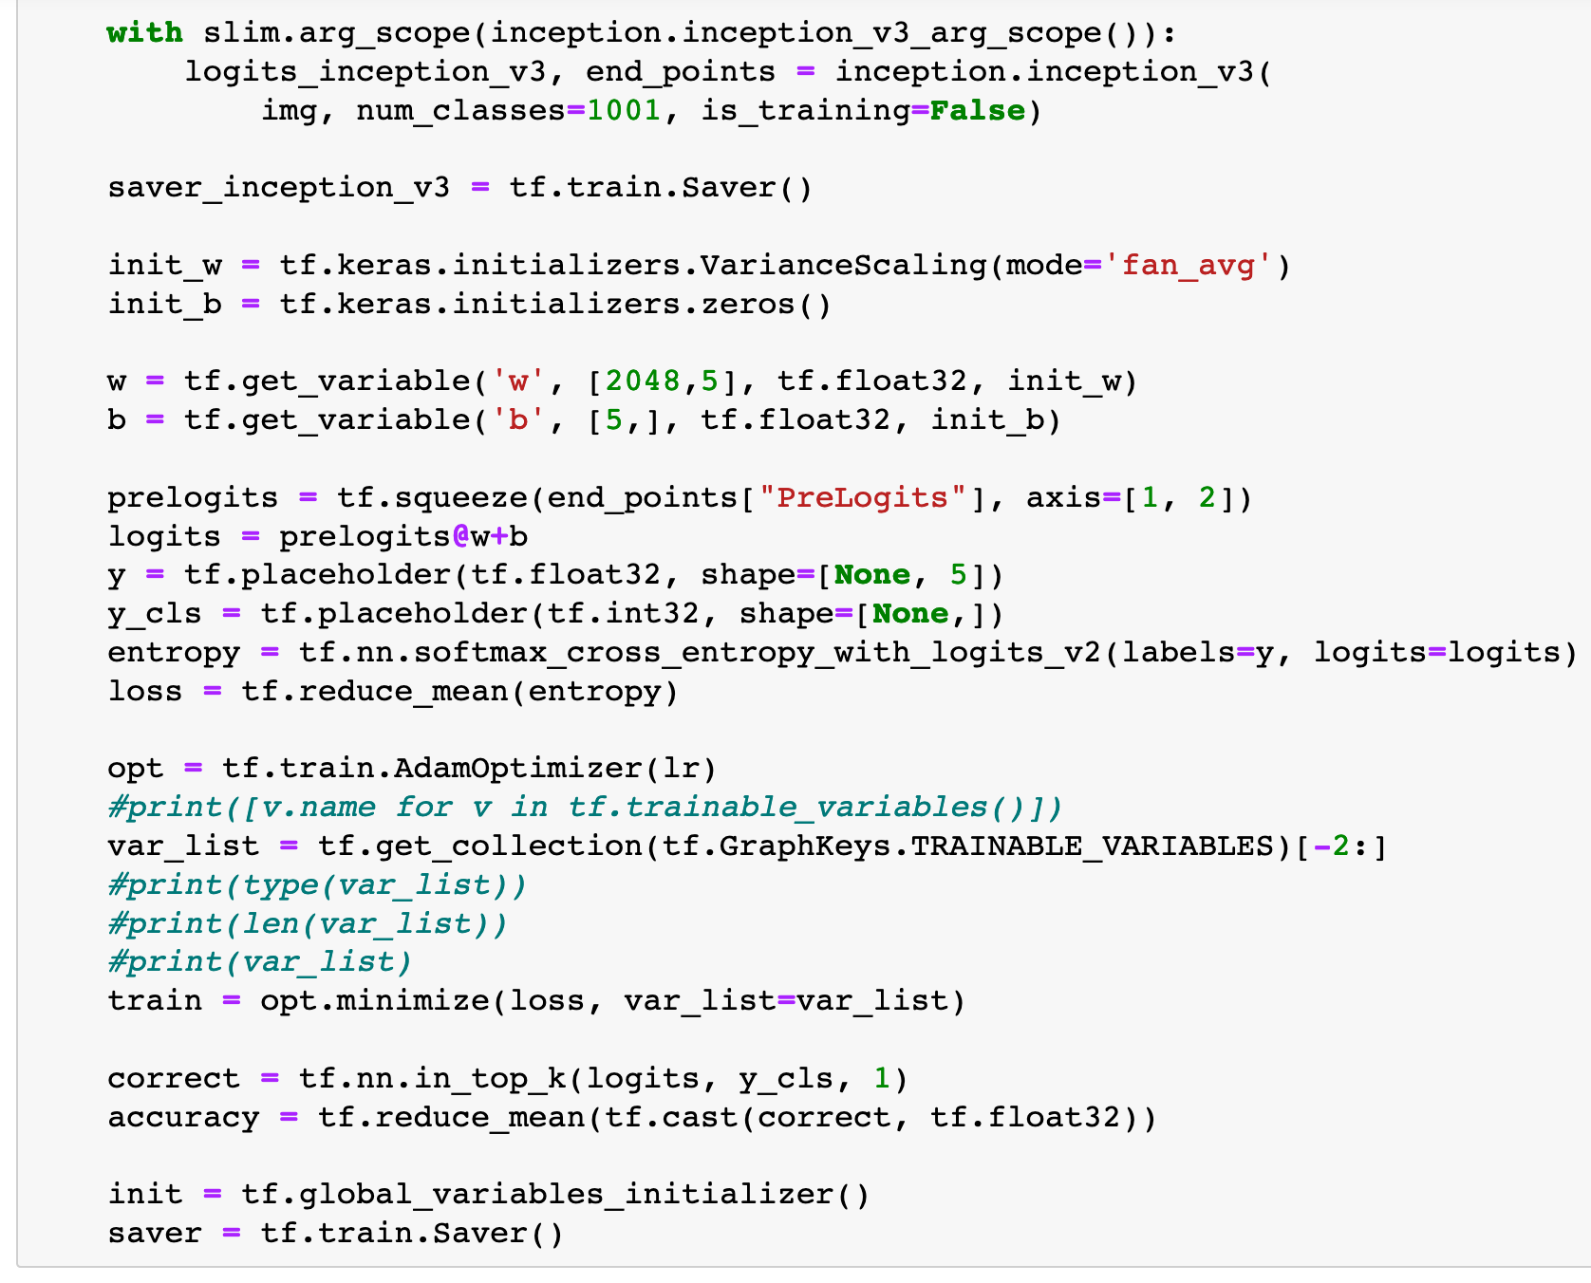

Slide 49
[w, b]

Slide 50
[w, b]
Only weights in var_list are
updated

Slide 51
[w, b]
Only weights in var_list are
updated
saver

Slide 52
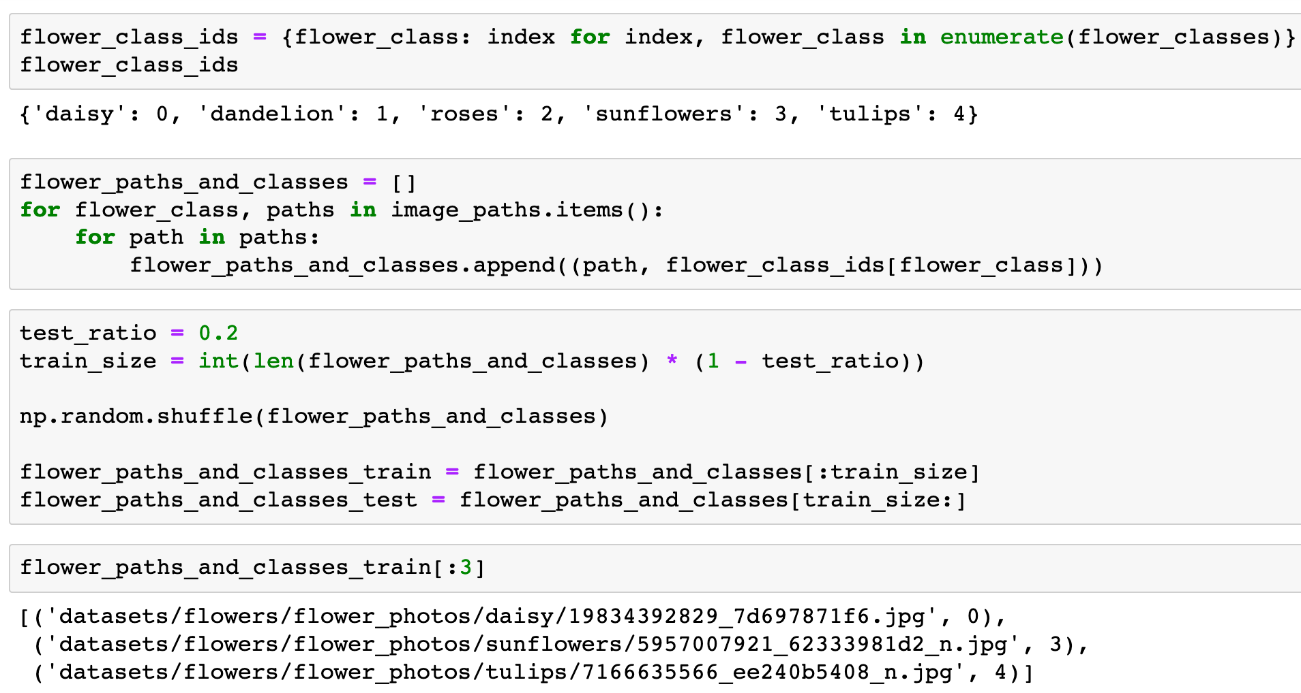

Slide 56
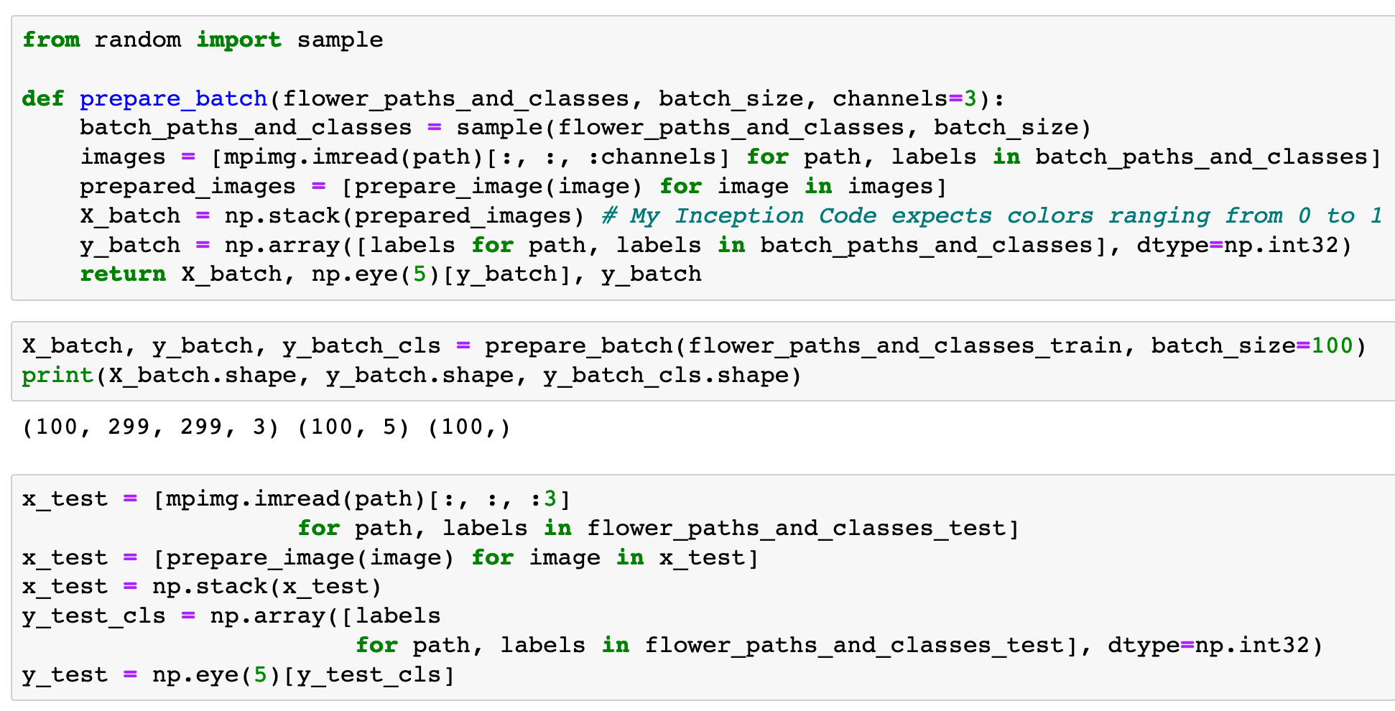

Slide 59
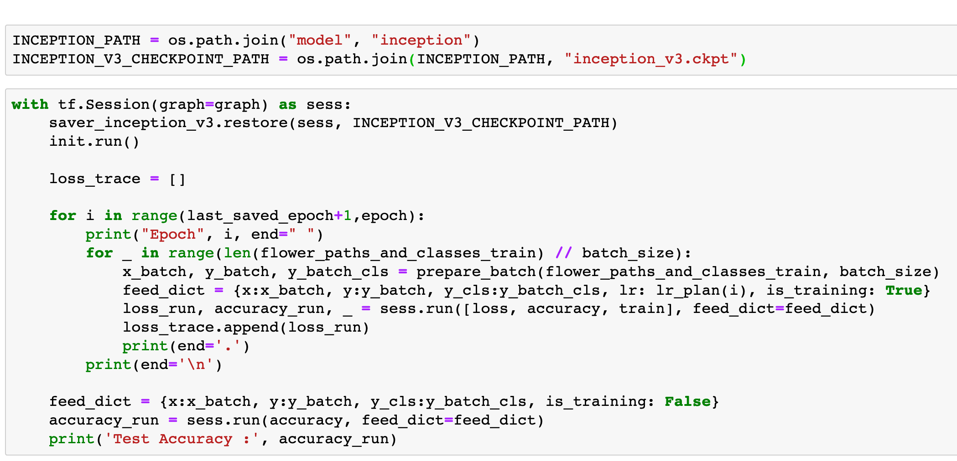
Without
save
and
restore

Slide 60
Without
save
and
restore
restore

Slide 61
Without
save
and
restore
restore
sess

Slide 62
Without
save
and
restore
restore
sess
ckpt path

Slide 63
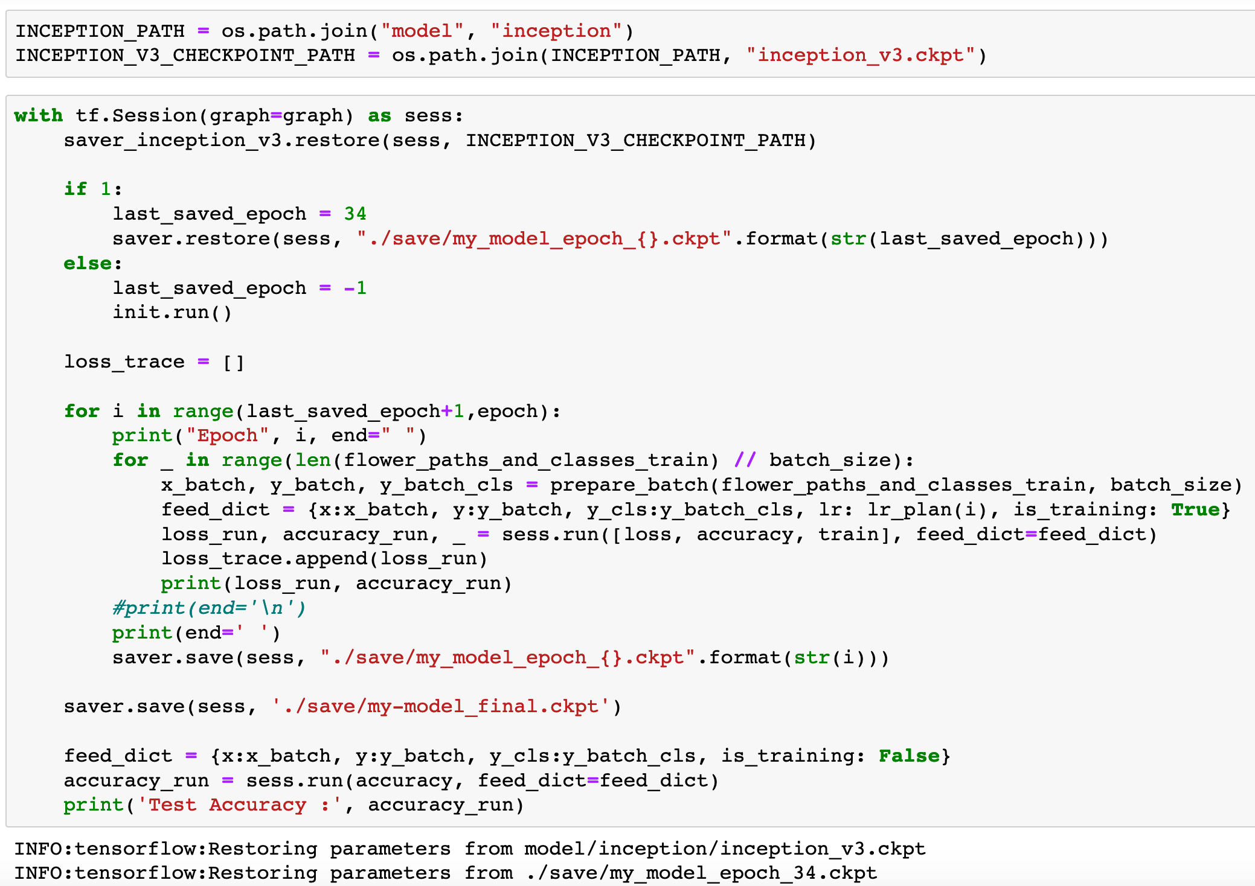
With
save
and
restore

Slide 64
With
save
and
restore
save

Slide 65
With
save
and
restore
sess
save

Slide 66
With
save
and
restore
sess
ckpt path
save

Slide 67
With
save
and
restore
save

Slide 68
With
save
and
restore
sess
save

Slide 69
With
save
and
restore
sess
ckpt path
save

Slide 70
With
save
and
restore
restore

Slide 71
With
save
and
restore
restore
sess

Slide 72
With
save
and
restore
restore
sess
ckpt path

Slide 73
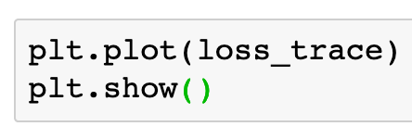

Slide 74
Now
Let’s Play with Code

